Slide 1
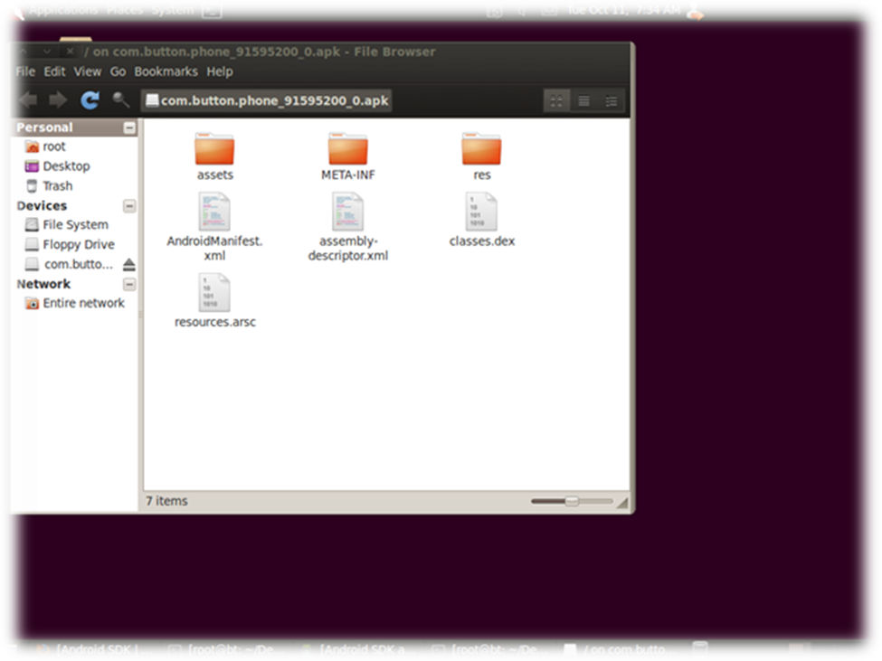
The Manifest File and Platform Security
Notes:
By default, all the activities in an application have an affinity for each other — that is, there's a preference for them all to belong to the same task. However, an individual affinity can be set for each activity with the taskAffinity attribute of the <activity> element. Activities defined in different applications can share an affinity, or activities defined in the same application can be assigned different affinities. The affinity comes into play in two circumstances: When the Intent object that launches an activity contains the FLAG_ACTIVITY_NEW_TASK flag, and when an activity has its allowTaskReparenting attribute set to "true".

Slide 2
Manifest File contents
Unique project specific name.
Describes the various components that make up the application including their type.
Capabilities associated with each component.
Permissions required to access protected APIs and to interact with other applications.
Permissions needed by other applications in order to interact with the application.
Lists any dependent libraries that the application uses.

Slide 3
Structure of the Manifest File
The AndroidManifest.xml file is, as its name suggests merely an XML based file used to specify the attributes and settings associated with the application.
The outline XML file in the hand out gives the general structure of the manifest file, listing all possible elements that it may contain.

Slide 4
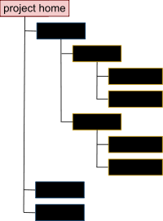
File Conventions
Some conventions and rules apply generally to all elements and attributes in the manifest:
  Elements
  Attributes
  Declaring class names
  Multiple Values
  Resourse Values
  String Values
  .
Notes:
If the launch mode of the designated activity is "standard", it too will be removed from the stack, and a new instance will be launched to handle the incoming intent. That's because a new instance is always created for a new intent when the launch mode is "standard".
FLAG_ACTIVITY_CLEAR_TOP is most often used in conjunction with FLAG_ACTIVITY_NEW_TASK. When used together, these flags are a way of locating an existing activity in another task and putting it in a position where it can respond to the intent.

Slide 5

Elements
Only the <manifest> and <application> elements are required, they each must be present and can occur only once. Most of the others can occur many times or not at all — although at least some of them must be present for the manifest to accomplish anything meaningful.
If an element contains anything at all, it contains other elements. All values are set through attributes, not as character data within an element.
Elements at the same level are generally not ordered. For example, <activity>, <provider>, and <service> elements can be intermixed in any sequence.

Slide 6
Attributes
In a formal sense, all attributes are optional. However, there are some that must be specified for an element to accomplish its purpose. Use the documentation as a guide. For truly optional attributes, it mentions a default value or states what happens in the absence of a specification.
Except for some attributes of the root <manifest> element, all attribute names begin with an android: prefix — for example, android:alwaysRetainTaskState. Because the prefix is universal, the documentation generally omits it when referring to attributes by name.

Slide 7
Declaring Class Names
Many elements correspond to Java objects, including elements for the application itself (the <application> element) and its principal components — activities (<activity>), services (<service>), broadcast receivers (<receiver>), and content providers (<provider>).
See hand out
Notes:
If you define a subclass, as you almost always would for the component classes (Activity, Service, BroadcastReceiver, and ContentProvider), the subclass is declared through a name attribute. The name must include the full package designation. For example, an Service subclass might be declared as follows:
See Hand out

Slide 8
Multiple Values
If more than one value can be specified, the element is almost always repeated, rather than listing multiple values within a single element. For example, an intent filter can list several actions:
<intent-filter . . . >
<action android:name="android.intent.action.EDIT" />
<action android:name="android.intent.action.INSERT" />
<action android:name="android.intent.action.DELETE" />
. . .
</intent-filter>

Slide 9
Resource Values
Some attributes have values that can be displayed to users — for example, a label and an icon for an activity. The values of these attributes should be localized and therefore set from a resource or theme. Resource values are expressed in the following format,
  @[package:]type:name
where the package name can be omitted if the resource is in the same package as the application, type is a type of resource — such as "string" or "drawable" — and name is the name that identifies the specific resource. For example:
  <activity android:icon="@drawable/smallPic" . . . >
Values from a theme are expressed in a similar manner, but with an initial '?' rather than '@':
  ?[package:]type:name
Notes:
The modes differ from each other on these four points:
Which task will hold the activity that responds to the intent. For the "standard" and "singleTop" modes, it's the task that originated the intent (and called startActivity()) — unless the Intent object contains the FLAG_ACTIVITY_NEW_TASK flag. In that case, a different task is chosen as described in the previous section, Affinities and new tasks.
In contrast, the "singleTask" and "singleInstance" modes mark activities that are always at the root of a task. They define a task; they're never launched into another task.
Whether there can be multiple instances of the activity. A "standard" or "singleTop" activity can be instantiated many times. They can belong to multiple tasks, and a given task can have multiple instances of the same activity.
In contrast, "singleTask" and "singleInstance" activities are limited to just one instance. Since these activities are at the root of a task, this limitation means that there is never more than a single instance of the task on the device at one time.
Whether the instance can have other activities in its task. A "singleInstance" activity stands alone as the only activity in its task. If it starts another activity, that activity will be launched into a different task regardless of its launch mode — as if FLAG_ACTIVITY_NEW_TASK was in the intent. In all other respects, the "singleInstance" mode is identical to "singleTask".
The other three modes permit multiple activities to belong to the task. A "singleTask" activity will always be the root activity of the task, but it can start other activities that will be assigned to its task. Instances of "standard" and "singleTop" activities can appear anywhere in a stack.
Whether a new instance of the class will be launched to handle a new intent. For the default "standard" mode, a new instance is created to respond to every new intent. Each instance handles just one intent. For the "singleTop" mode, an existing instance of the class is re-used to handle a new intent if it resides at the top of the activity stack of the target task. If it does not reside at the top, it is not re-used. Instead, a new instance is created for the new intent and pushed on the stack.

Slide 10
String Values
Where an attribute value is a string, double backslashes ('\\') must be used to escape characters.
  for example, '\\n' for a newline or \\uxxxx' for a Unicode character.

Slide 11
File Features
Intent Filters
Icons and Labels
Notes:
The core components of an application (its activities, services, and broadcast receivers) are activated by intents. An intent is a bundle of information (an Intent object) describing a desired action — including the data to be acted upon, the category of component that should perform the action, and other pertinent instructions. Android locates an appropriate component to respond to the intent, launches a new instance of the component if one is needed, and passes it the Intent object.
Components advertise their capabilities — the kinds of intents they can respond to — through intent filters. Since the Android system must learn which intents a component can handle before it launches the component, intent filters are specified in the manifest as <intent-filter> elements. A component may have any number of filters, each one describing a different capability.
An intent that explicitly names a target component will activate that component; the filter doesn't play a role. But an intent that doesn't specify a target by name can activate a component only if it can pass through one of the component's filters.
For information on how Intent objects are tested against intent filters, see a separate document, Intents and Intent Filters
Icons and Labels
A number of elements have icon and label attributes for a small icon and a text label that can be displayed to users. Some also have a description attribute for longer explanatory text that can also be shown on-screen. For example, the <permission> element has all three of these attributes, so that when the user is asked whether to grant the permission to an application that has requested it, an icon representing the permission, the name of the permission, and a description of what it entails can all be presented to the user.
In every case, the icon and label set in a containing element become the default icon and label settings for all of the container's subelements. Thus, the icon and label set in the <application> element are the default icon and label for each of the application's components. Similarly, the icon and label set for a component — for example, an <activity> element — are the default settings for each of the component's <intent-filter> elements. If an <application> element sets a label, but an activity and its intent filter do not, the application label is treated as the label for both the activity and the intent filter.
The icon and label set for an intent filter are used to represent a component whenever the component is presented to the user as fulfilling the function advertised by the filter. For example, a filter with "android.intent.action.MAIN" and "android.intent.category.LAUNCHER" settings advertises an activity as one that initiates an application — that is, as one that should be displayed in the application launcher. The icon and label set in the filter are therefore the ones displayed in the launcher.

Slide 12
Android Security
Android is a multi-process system, in which each application (and parts of the system) runs in its own process.
Most security between applications and the system is enforced at the process level through standard Linux facilities, such as user and group IDs that are assigned to applications.
Additional more specific security features are provided through a "permission" mechanism that enforces restrictions on the specific operations that a particular process can perform, and per-URI permissions for granting ad-hoc access to specific pieces of data.

Slide 13

Security Components
Application Signing
URI Permissions
Permissions
Libraries

Slide 14
Application Signing
All Android applications (.apk files) must be signed with a certificate whose private key is held by their developer. This certificate identifies the author of the application.
The certificate does not need to be signed by a certificate authority: it is perfectly allowable, and typical, for Android applications to use self-signed certificates.
The certificate is used only to establish trust relationships between applications, not for wholesale control over whether an application can be installed.
The most significant ways that signatures impact security is by determining who can access signature-based permissions and who can share user IDs.

Slide 15
URI Permissions
The standard permission system described so far is often not sufficient when used with content providers. A content provider may want to protect itself with read and write permissions, while its direct clients also need to hand specific URIs to other applications for them to operate on.
Notes:
The standard permission system described so far is often not sufficient when used with content providers. A content provider may want to protect itself with read and write permissions, while its direct clients also need to hand specific URIs to other applications for them to operate on. A typical example is attachments in a mail application. Access to the mail should be protected by permissions, since this is sensitive user data. However, if a URI to an image attachment is given to an image viewer, that image viewer will not have permission to open the attachment since it has no reason to hold a permission to access all e-mail.
The solution to this problem is per-URI permissions: when starting an activity or returning a result to an activity, the caller can set Intent.FLAG_GRANT_READ_URI_PERMISSION and/or Intent.FLAG_GRANT_WRITE_URI_PERMISSION. This grants the receiving activity permission access the specific data URI in the Intent, regardless of whether it has any permission to access data in the content provider corresponding to the Intent.
This mechanism allows a common capability-style model where user interaction (opening an attachment, selecting a contact from a list, etc) drives ad-hoc granting of fine-grained permission. This can be a key facility for reducing the permissions needed by applications to only those directly related to their behaviour.

Slide 16
Permissions
A permission is a restriction limiting access to a part of the code or to data on the device
  android.permission.CALL_EMERGENCY_NUMBERS
  android.permission.READ_OWNER_DATA
  android.permission.SET_WALLPAPER
  android.permission.DEVICE_POWER
Notes:
A permission is a restriction limiting access to a part of the code or to data on the device. The limitation is imposed to protect critical data and code that could be misused to distort or damage the user experience.
Each permission is identified by a unique label. Often the label indicates the action that's restricted. For example, here are some permissions defined by Android:
android.permission.CALL_EMERGENCY_NUMBERS
android.permission.READ_OWNER_DATA
android.permission.SET_WALLPAPER
android.permission.DEVICE_POWER
A feature can be protected by at most one permission.
If an application needs access to a feature protected by a permission, it must declare that it requires that permission with a <uses-permission> element in the manifest. Then, when the application is installed on the device, the installer determines whether or not to grant the requested permission by checking the authorities that signed the application's certificates and, in some cases, asking the user. If the permission is granted, the application is able to use the protected features. If not, its attempts to access those features will simply fail without any notification to the user.
An application can also protect its own components (activities, services, broadcast receivers, and content providers) with permissions. It can employ any of the permissions defined by Android (listed in android.Manifest.permission) or declared by other applications. Or it can define its own. A new permission is declared with the <permission> element. For example, an activity could be protected as follows:
GIVE OUT HAND OUT

Slide 17
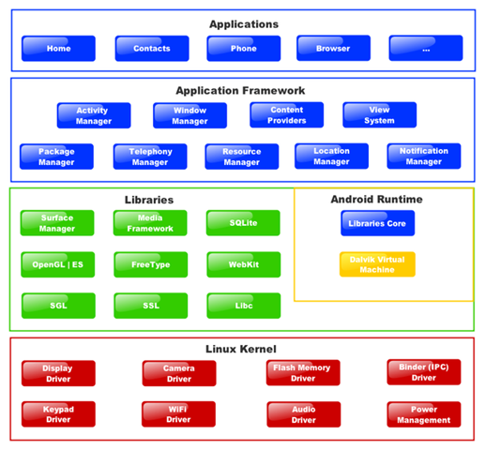
Libraries
Every application is linked against the default Android library, which includes the basic packages for building applications
(with common classes
such as Activity, Service,
Intent, View, Button,
Application,
ContentProvider,
and so on).
Notes:
However, some packages reside in their own libraries. If your application uses code from any of these packages, it must explicitly asked to be linked against them. The manifest must contain a separate <uses-library> element to name each of the libraries. (The library name can be found in the documentation for the package.)

